Slide 1

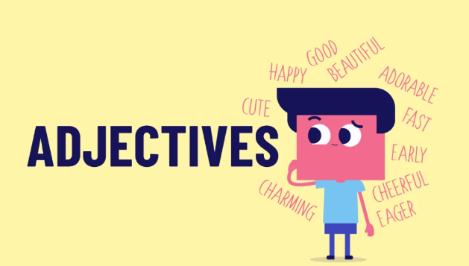
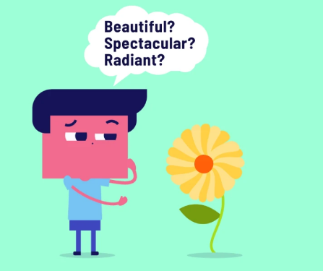
In the Name of God
Adjectives modify nouns

Slide 2
Types of adjectives:
Feelings/qualities | Nationality/origin | Age | Size | Color
honest | Iranian | new | large | red
miserable | Australian | young | small | green
respectful | German | teenage | fat | white
confident | Chinese | old | tiny | maroon
anxious | French | antique | tall | purple
Shape | Material | Number | Judgment/value | Possessives and demonstratives
round | wooden | one | complicated | her/his
square | metal | fourteen | ingenious | my
oval | plastic | second | ambiguous | our
triangular | gold | few | simple | this/that
rectangular | paper | several | strong | these/those

Slide 3
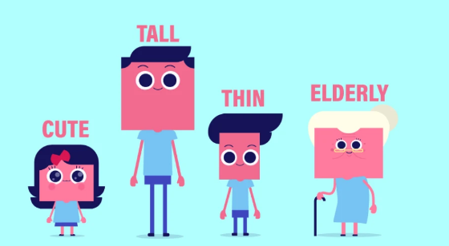

Slide 4

Where is the adjective in a sentence?
Adjective + Noun: Aida generously shares her brief notes with Anahita.
Sense verb + Adjective: Taking online tests looks stressful.
Tobe verb + Adjective: AUT students are intelligent

Slide 5
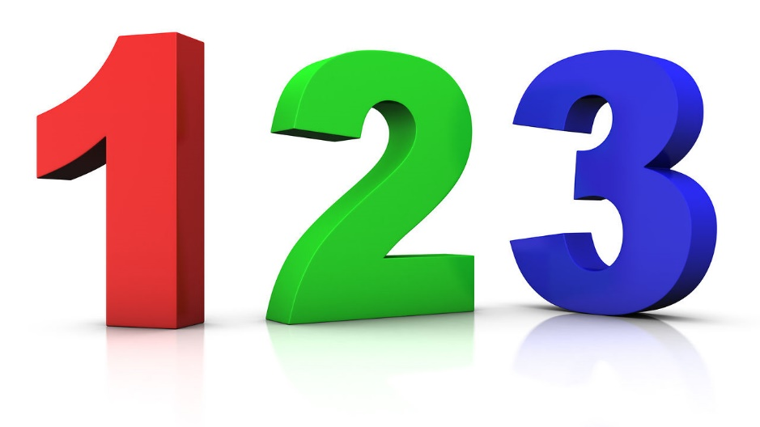
Comparative
Positive
Superlative

Slide 6
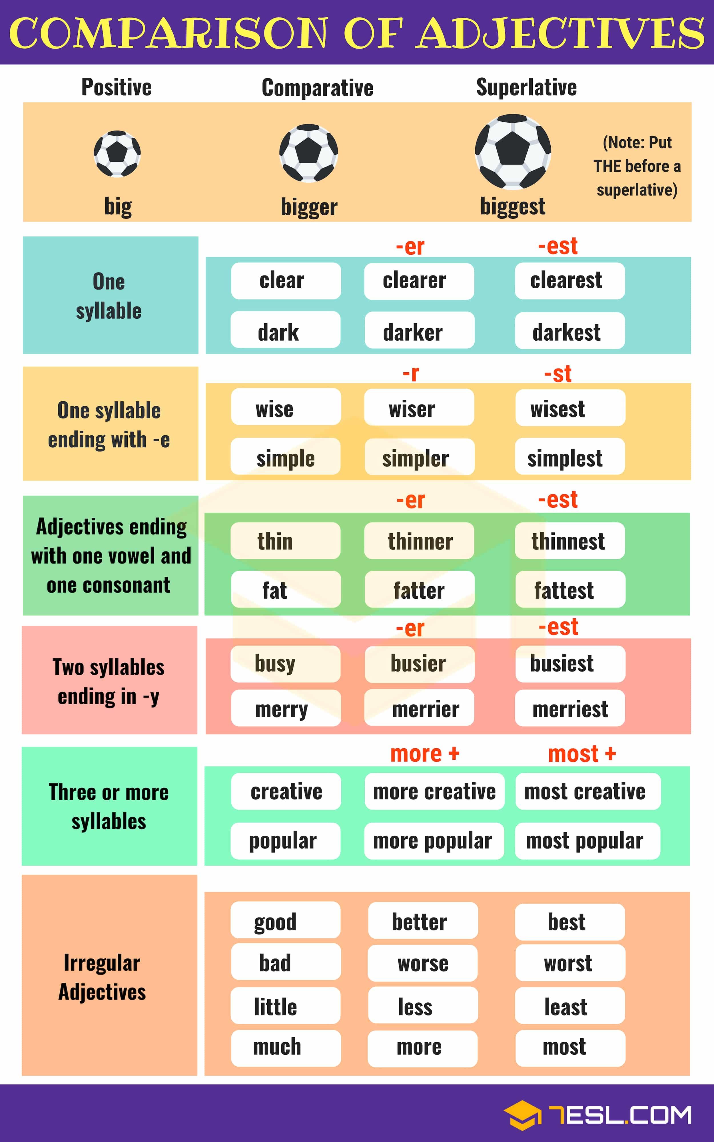
Superlatives:
Do not forget the!
Comparatives:
Do not forget than!

Slide 7
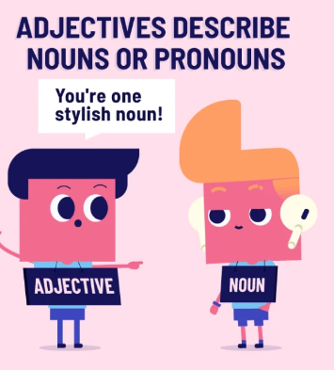
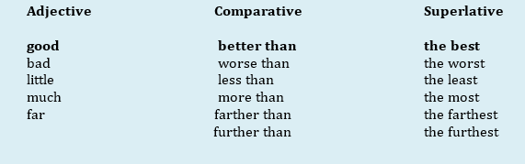
Irregular Comparatives and Superlatives

Slide 8
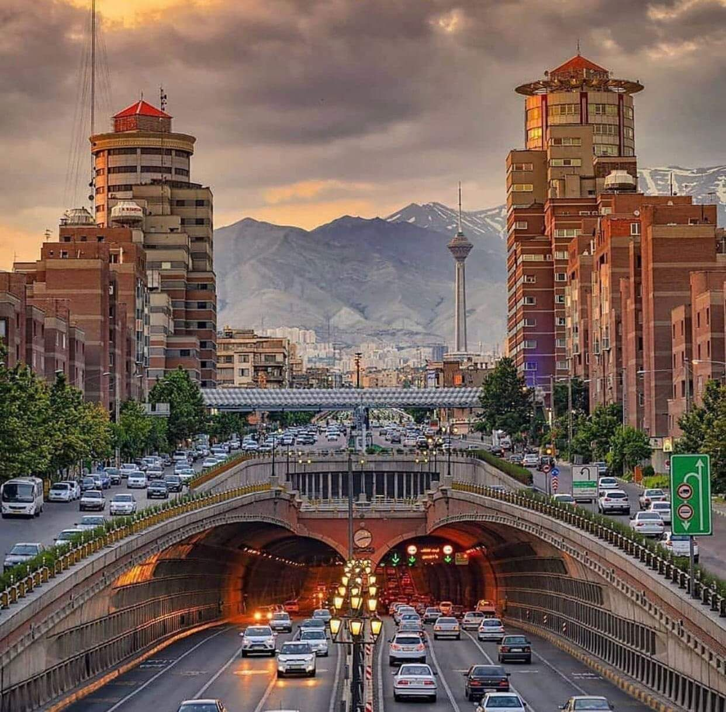
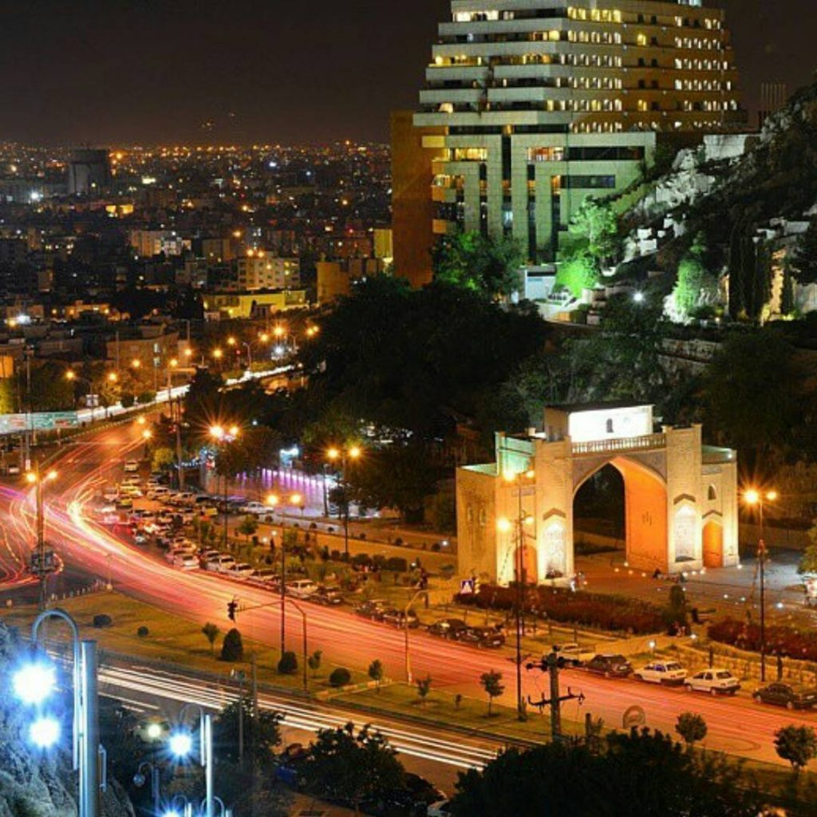

Slide 9

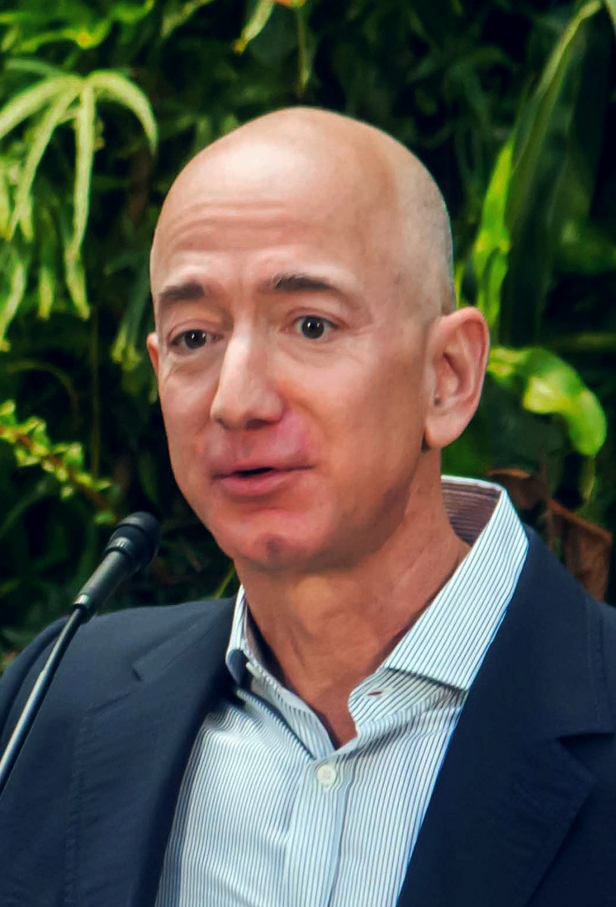

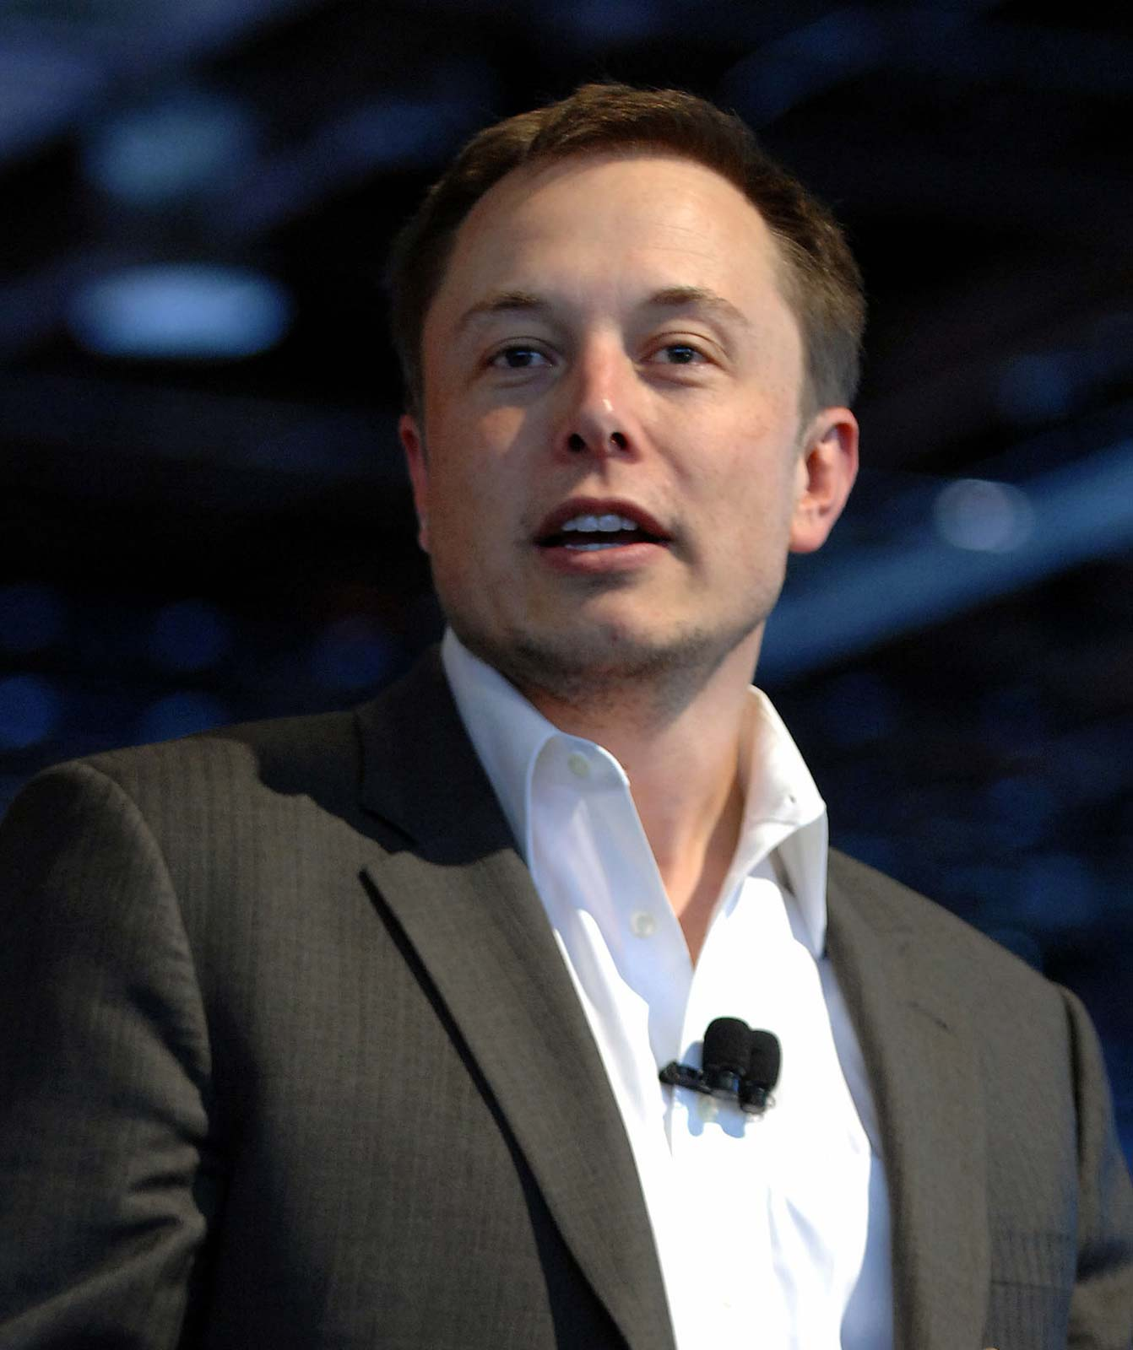

Slide 10
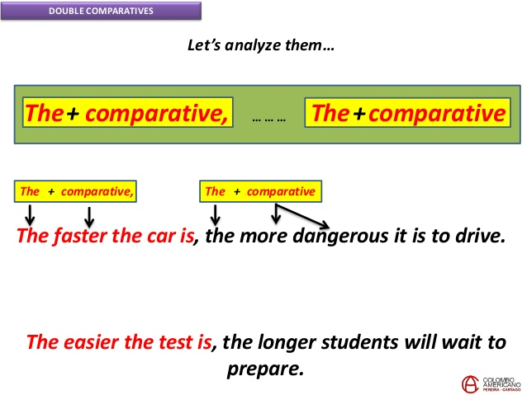
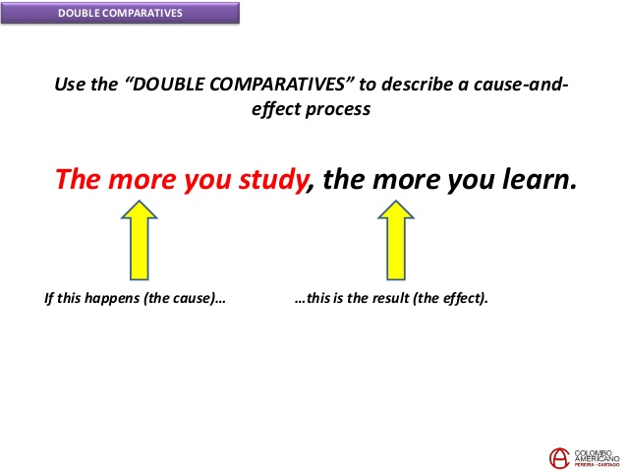

Slide 11
Common Adjective-Making Suffixes and Examples
-able/ible | visible, valuable | -ic | basic, sympathetic
-al | original, typical | -ing | boring, frightening
-ant | reliant, significant | -ish | Irish, stylish
-ary | primary, secondary | -ive | excessive, productive
-ed | bored, coordinated | -ous | ambiguous, enormous
-ent | efficient, persistent | -y | cheery, noisy, rainy
-ful | resourceful, stressful | -less | effortless, helpless
-ly | friendly, lovely | -ian | Iranian, African

Slide 12


